Slide 1
Statistical Process Control Final Project
By: Chase Banyai, Isabella Boone, Joel Gingrich, Andrew Januszko, Travis Myers, Kimberly O’Neill, Morgan Williams-Burrell
November 2020

Slide 2
Table of Contents
Topic
Gripper Manufacturing
Circuit Board Manufacturing
Software Development Process

Slide 3
Gripper Manufacturing
Can the cheaper process meet the requirements of the slip-on tip?
How much more precise is the more expensive manufacturing process?
Estimate the failure rate (the rate at which we produce fingers that are out of tolerance in at least one direction) for each process.
Suppose that adding the heating stage makes the two manufacturing processes equal in cost, that the slip-on tips cost 3 cents / 1000 tips while the shrinking tips cost 4 cents / 1000 tips, and that each failed finger costs 3 dollars each. Given the failure rates, which process is less expensive?

Slide 4
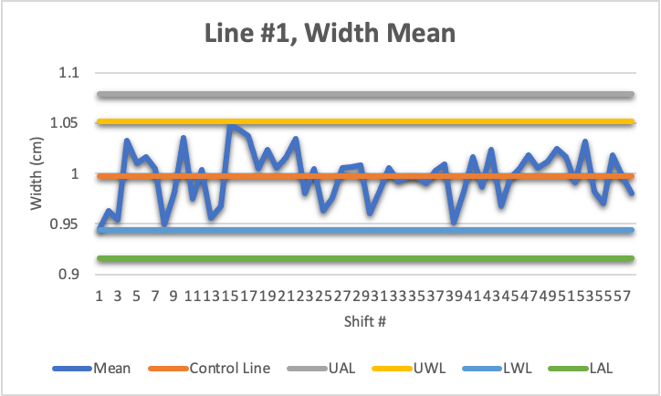
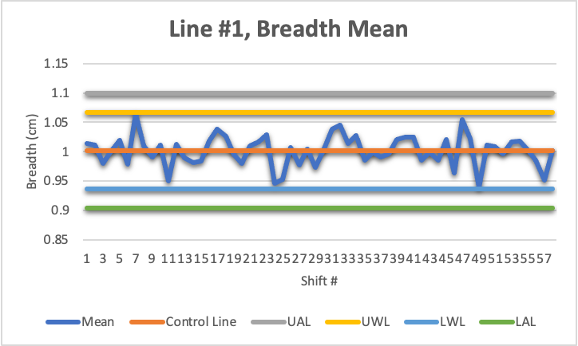
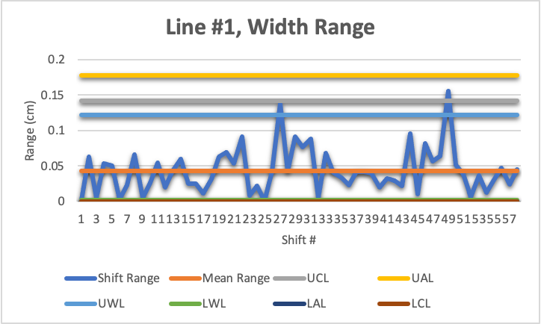
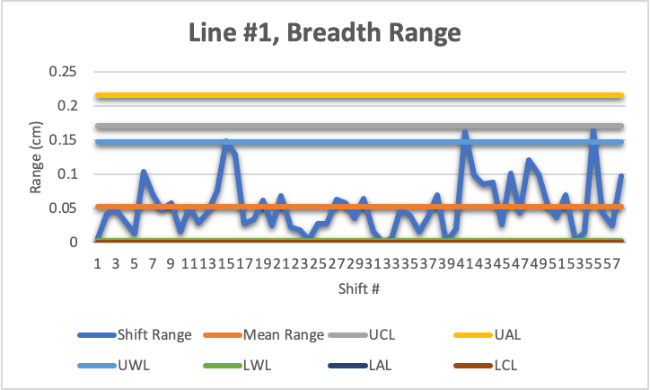
Line #1 Control Charts

Slide 5
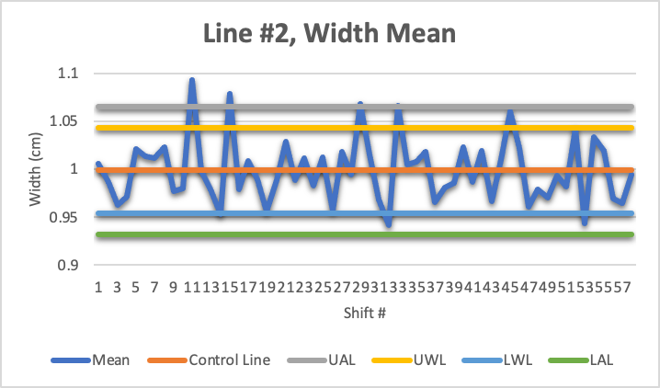
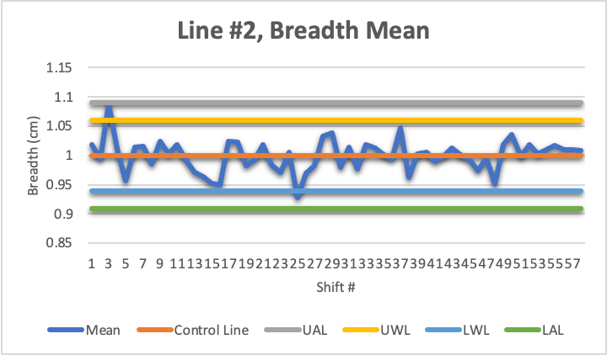
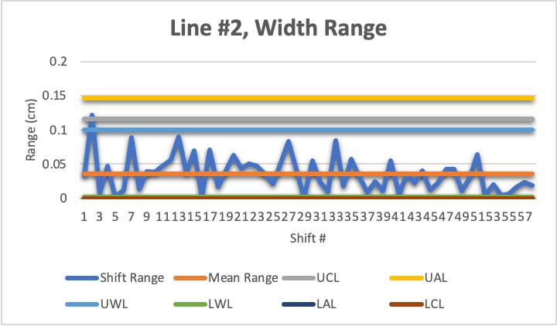
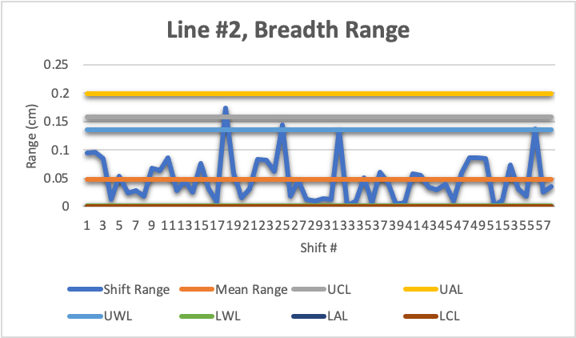
Line #2 Control Charts

Slide 6
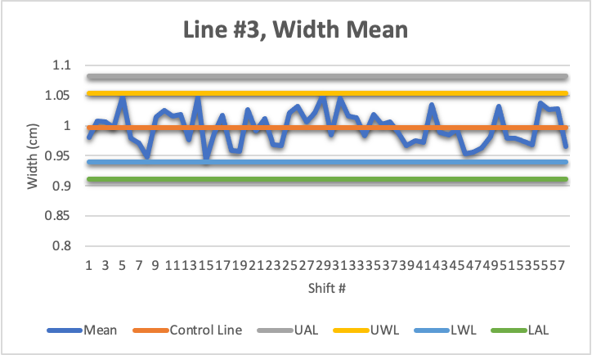
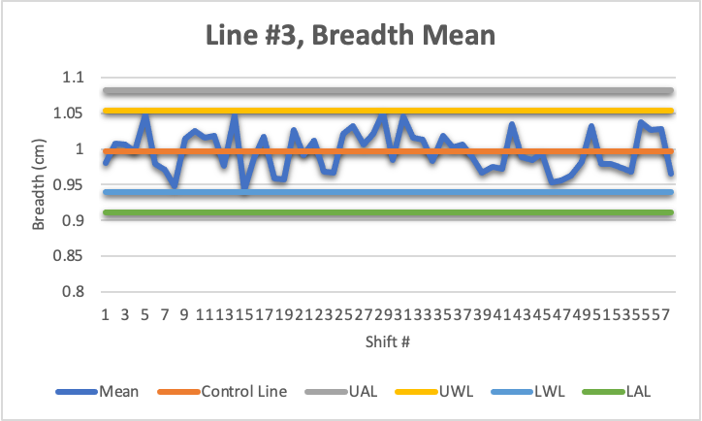
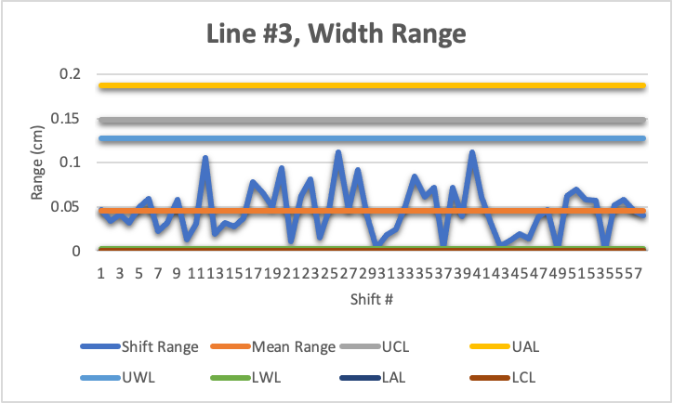
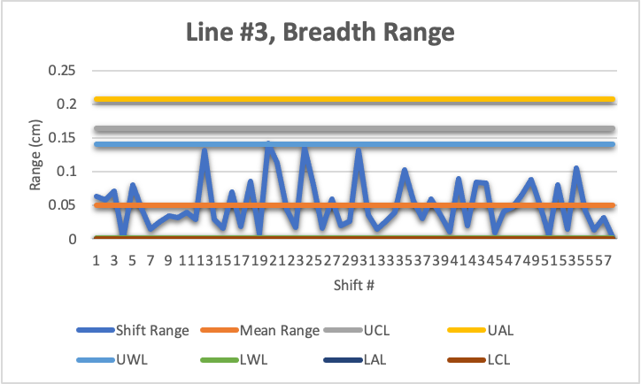
Line #3 Control Charts

Slide 7
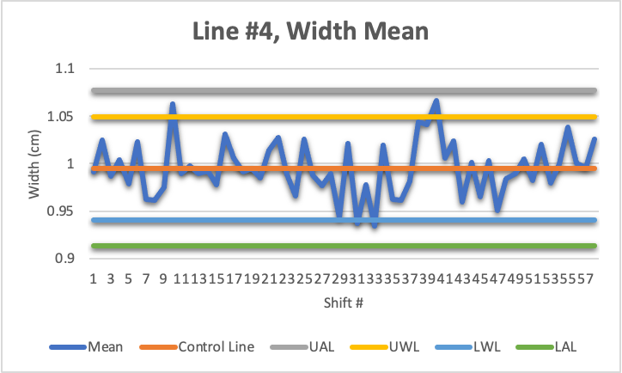
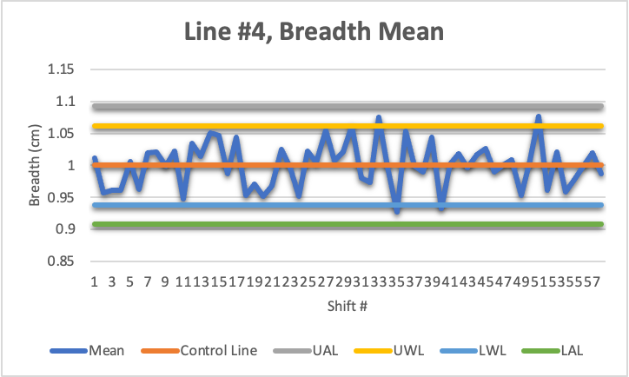
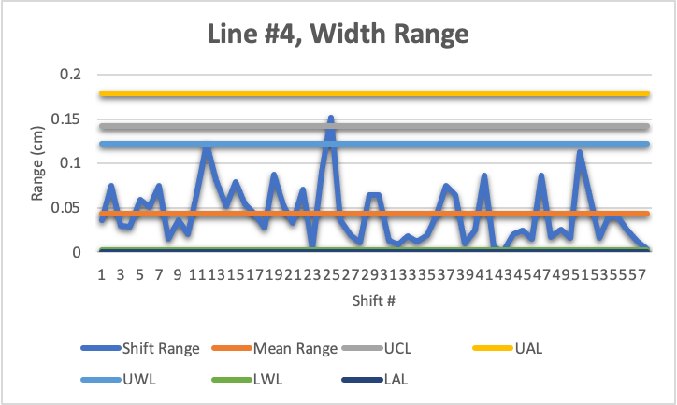
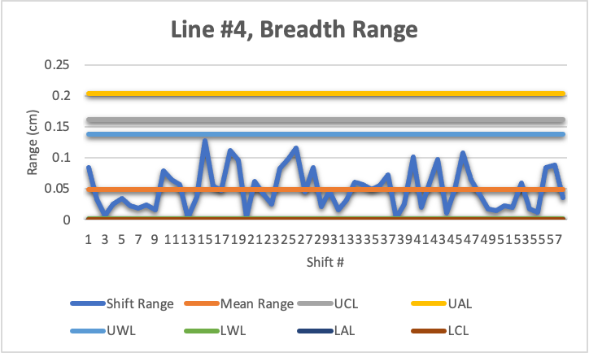
Line #4 Control Charts

Slide 8
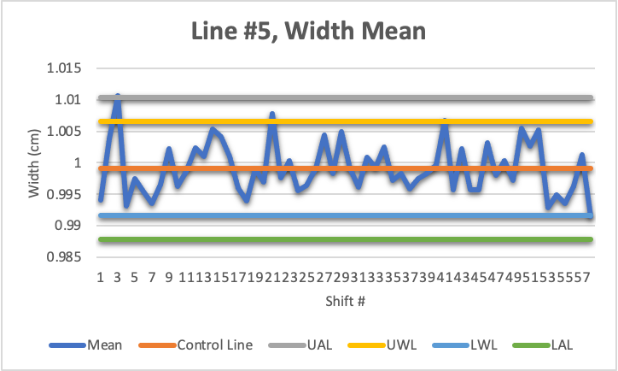
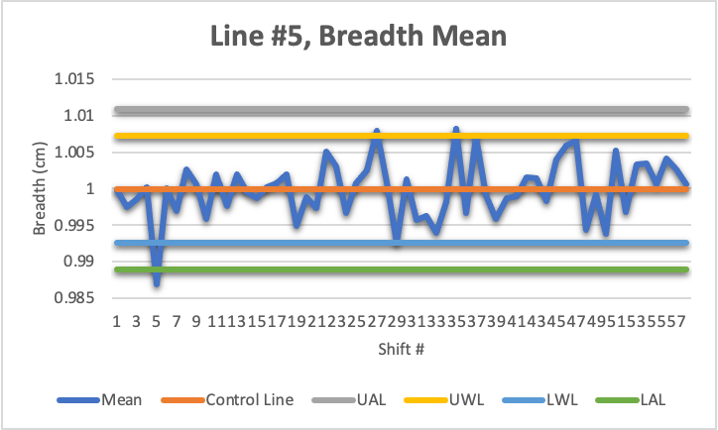
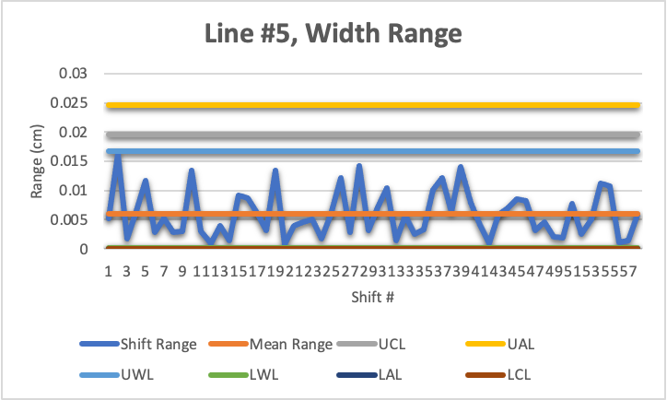
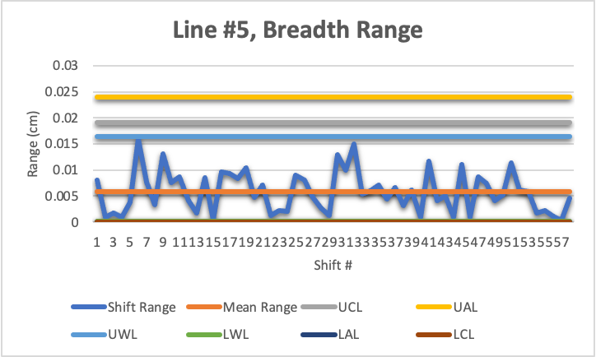
Line #5 Control Charts

Slide 9
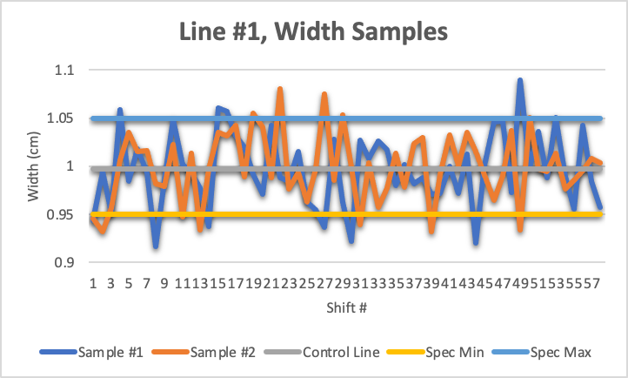
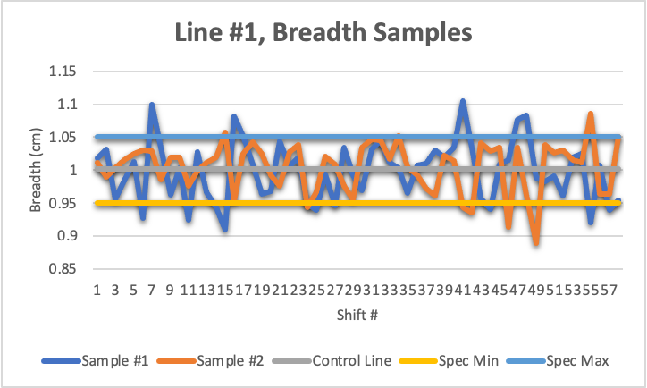
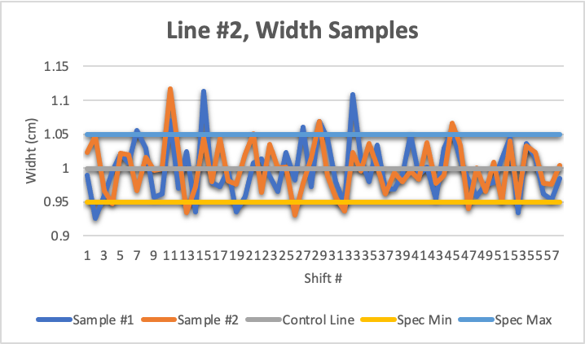
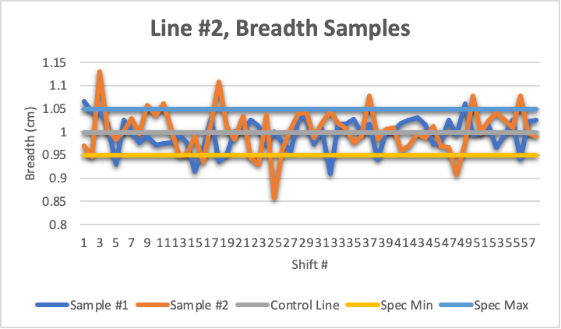
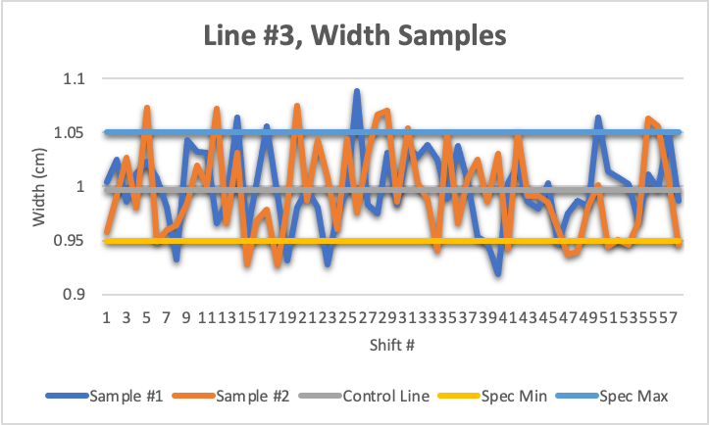
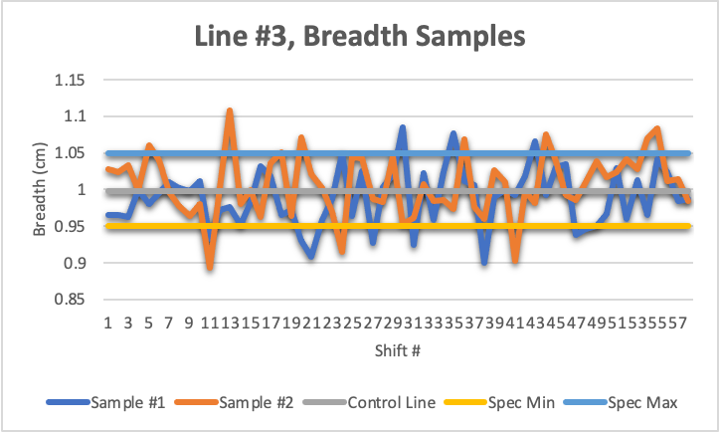
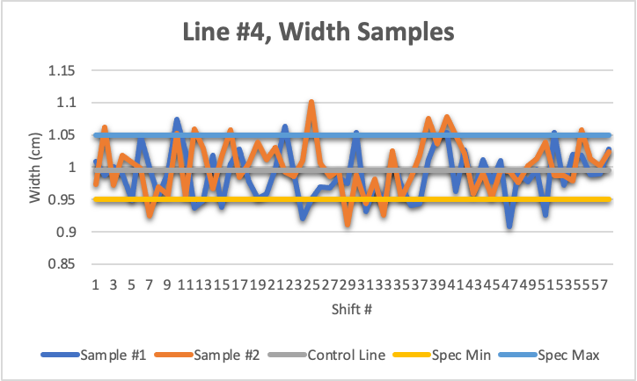
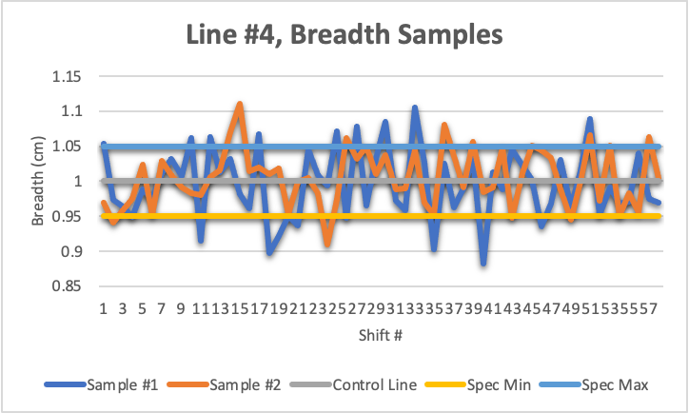
Gripper Manufacturing
Question #1 Response
No, the cheaper process cannot meet the requirements of the slip on tip. It frequently produces slip-on tips that are out of specification.
Line # | Width | Breadth
1 | 0.9976 ± 0.0432 | 1.0015 ± 0.0523
2 | 0.9988 ± 0.0356 | 0.9993 ± 0.0483
3 | 0.9968 ± 0.0455 | 0.9981 ± 0.0504
4 | 0.9976 ± 0.0432 | 1.0015 ± 0.0523

Slide 10
Gripper Manufacturing
Question #2 Response
On average, line #5 is more precise in width with a difference of 0.0360 cm and breadth with a difference of 0.0442 cm.
Line # | Width (Range) | Breadth (Range)
1 | 0.0432 | 0.0523
2 | 0.0356 | 0.0483
3 | 0.0455 | 0.0504
4 | 0.0435 | 0.0494
5 | 0.0060 | 0.0058

Slide 11
Gripper Manufacturing
Question #3 Response
In general:
Line #4 had the highest overall failure rate at 45.6896%
Line #5 had the lowest overall failure rate at 0.0000%
It should be noted that the cheaper process has an overall higher failure rate when compared to the more expensive one.
Line # | Total Failures | Failure Rate
1 | 42 | 36.2069%
2 | 41 | 35.3448%
3 | 47 | 40.5172%
4 | 53 | 45.6896%
5 | 0 | 0.0000%

Slide 12
Gripper Manufacturing
Question #4 Response
If both tips are equal in manufacturing cost, it would be cheaper to use the process on line #5. There would be more money lost in failures from lines #1-4.

Slide 13
Circuit Board Manufacturing
Background
A company makes circuit boards for a robotic arm. They work 24 hours a day with three shifts over a 24 hour period for 20 weeks.
The company is testing their boards to see how much of the surface is solderable. The two main factors are the copper plates and the temperature that they are etched at.
They gathered data for these 20 weeks, collecting a percentage of area that is solderable and the number of holes that didn’t solder.

Slide 14
Circuit Board Manufacturing
Questions
The criteria for the percentage of area that passes solderability is 95%. Is their process in control in relation to that statistic?
Did the change in temperature of their etching affect the solderability of the solder pads?
Did the change in the supplier of copper plates affect the number of holes that dip tin?

Slide 15
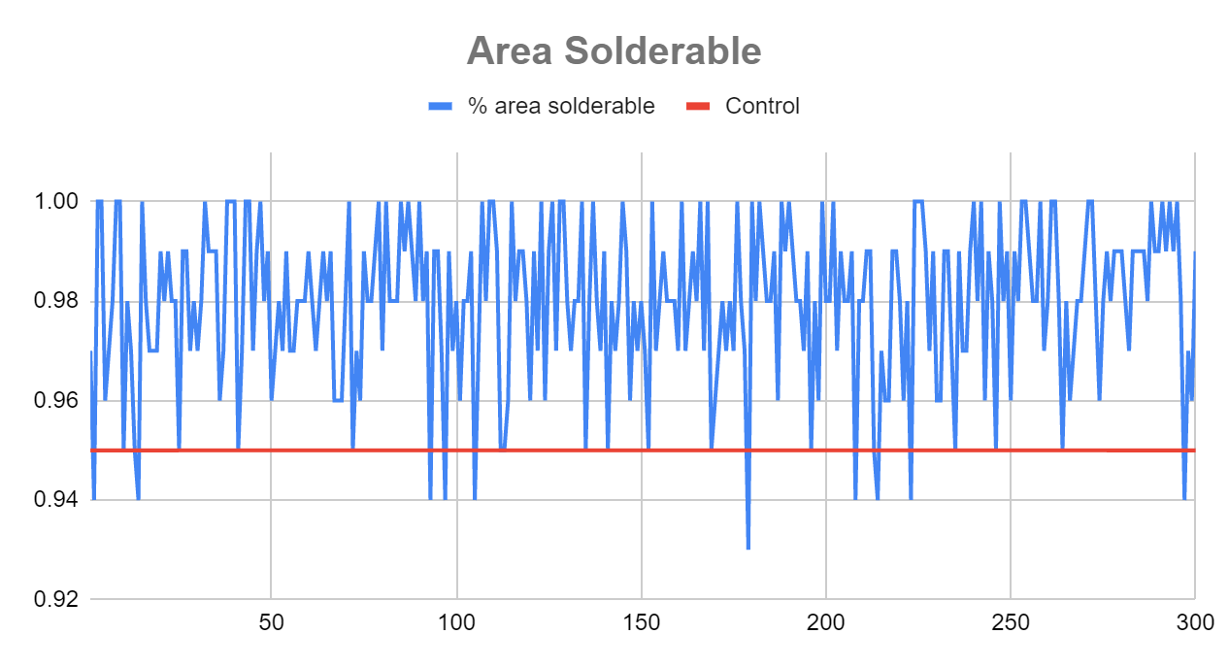
Circuit Board Manufacturing
Question 1 - Is their process in control?
Area Solderable
Amount Over .95 | 290 | 96.67%
Amount Under .95 | 10 | 3.33%

Slide 16
Circuit Board Manufacturing
Question 1 - Is their process in control?
Yes, The process is in control.
We have more than 96% above where we need it to be. Out of 300 boards, we had only 10 not able to be used.
With only 10 of the 300 boards not usable the process is in control.

Slide 17
Circuit Board Manufacturing
Question 2 - Did the change in temperature of their etching affect the solderability of the solder pads?
Remember: at week 16, they changed the temperature at which their acid etcher was operating.
So, we are comparing all of the data from week 1-15 to week 16-20.
Specification Comparison
 | Day 1-79 | Day 80-100 | Day 1-79 % | Day 80-100 %
Amount Over .95 | 216 | 74 | 96.00% | 98.67%
Amount Under .95 | 9 | 1 | 4.00% | 1.33%

Slide 18
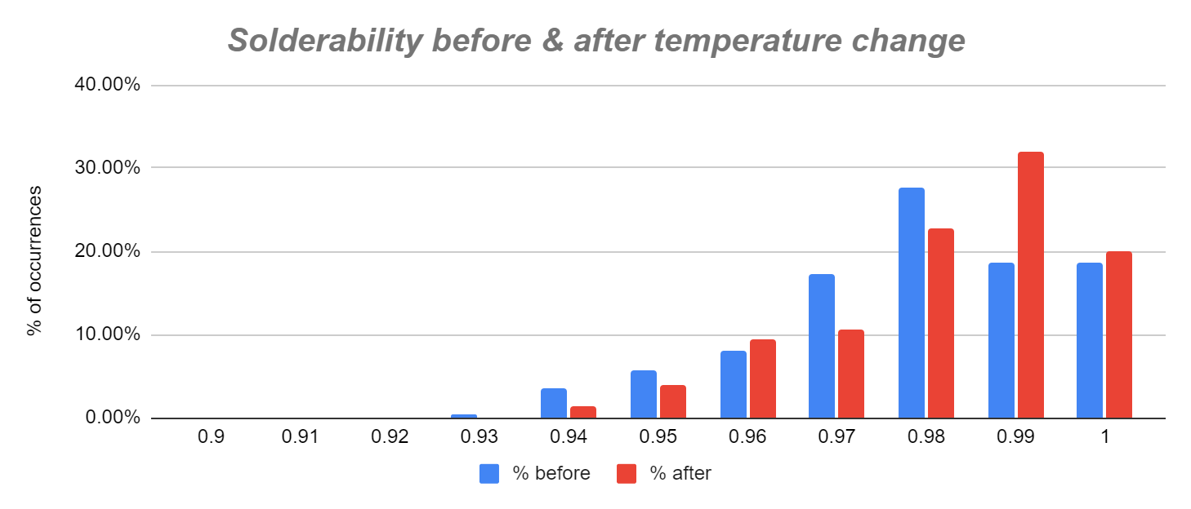
Circuit Board Manufacturing
Question 2 - Did a change in temperature affect the solderability?

Slide 19
Circuit Board Manufacturing
Question 2 - Conclusion
Before the temperature change, the amount of area solderable that is above the 95% specification is around 96% of all data. After the temperature change, that number shifts to 98.67%. You can see in the graph that there is also an overall increase in the percentages.
Therefore, the change in temperature affected the solderability.

Slide 20
Circuit Board Manufacturing
Question 3 - Did the change in the supplier of copper plates affect the number of holes that dip tin?
Remember: at week 10, they changed their supplier of copper plates.
So, we are comparing all of the data from week 1-9 to week 10-20.
Data | Before | After | % before | % after
0 | 129 | 150 | 95.56% | 90.91%
1 | 1 | 6 | 0.74% | 3.64%
2 | 4 | 4 | 2.96% | 2.42%
3 | 1 | 4 | 0.74% | 2.42%
4 | 0 | 1 | 0.00% | 0.61%
Total | 135 | 165
% holes > 0 |  |  | 4.44% | 9.09%

Slide 21
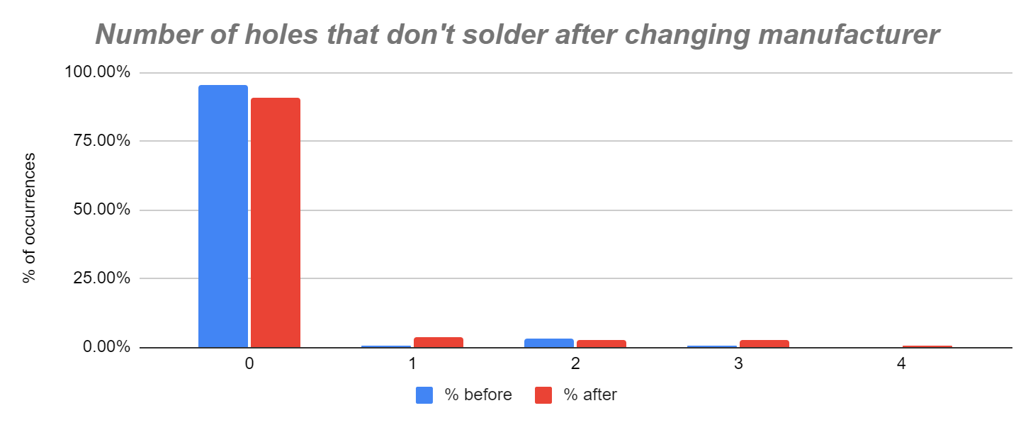
Circuit Board Manufacturing
Question 3 - Did the change in the supplier of copper plates affect the number of holes that dip tin?

Slide 22
Circuit Board Manufacturing
Question 3 - Conclusion
The overall number of holes shifted from 4.44% to 9.09% after the change in manufacturer, and the overall number of plates with 0 holes shifted from 95.56% to 90.91%.
There is an overall increase in holes after switching manufacturing, and is most likely the reason for the increase.

Slide 23
Software Development Process
Background
A software development team is developing a piece of software using agile programming . The project goes on for 60 weeks.
Week 18: Hired new employee
Weeks 28 and 29: Swine Flu
Week 35: New development environment
Week 43: One employee left
Week 48: Hired back an old employee
Staffing
Defects per package
Package size
Average Cyclomatic Complexity

Slide 24
Software Development Process
1. Evaluate the team's productivity.
2. Evaluate the quality of the software the team is producing.
3. Evaluate the impact changing the development environment had on productivity.
4. Is cyclomatic complexity a good predictor for defects?

Slide 25
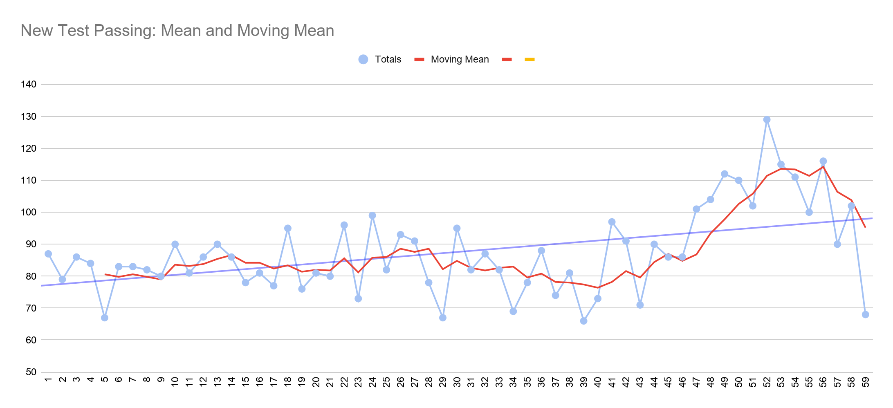
Software Development Process
Evaluate the team's productivity
Hired Old Employee
Swine Flu
New Employee
Employee left
New DE

Slide 26
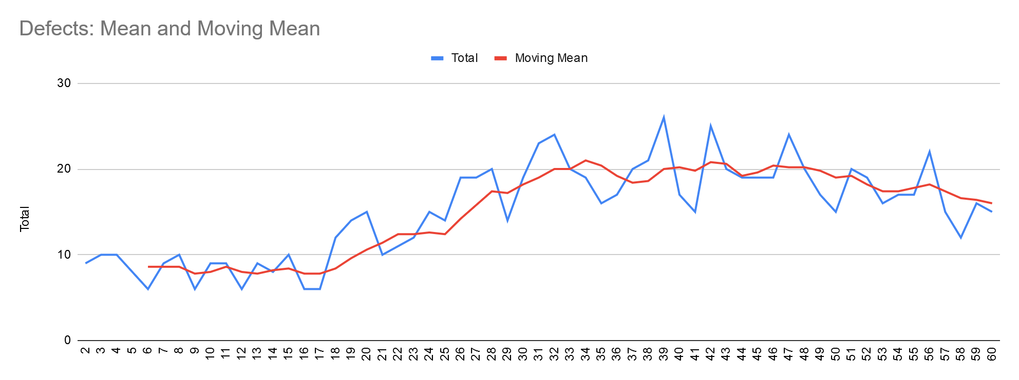
Software Development Process
Evaluate the quality of the software the team is producing.
Package E & G added
New Employee

Slide 27
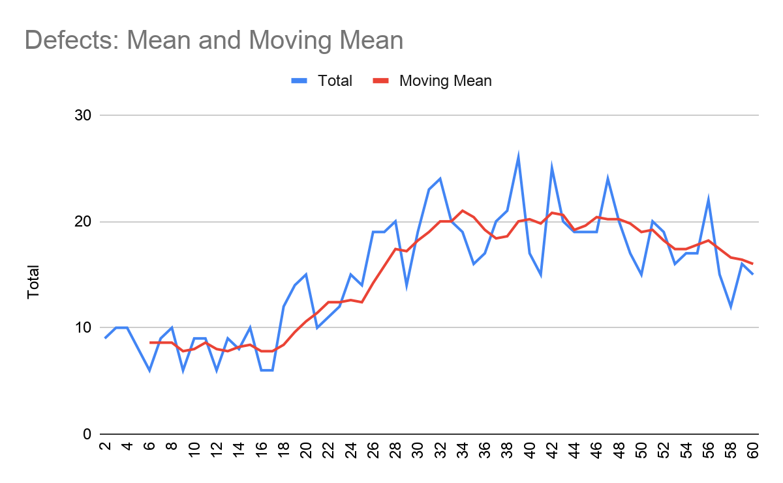
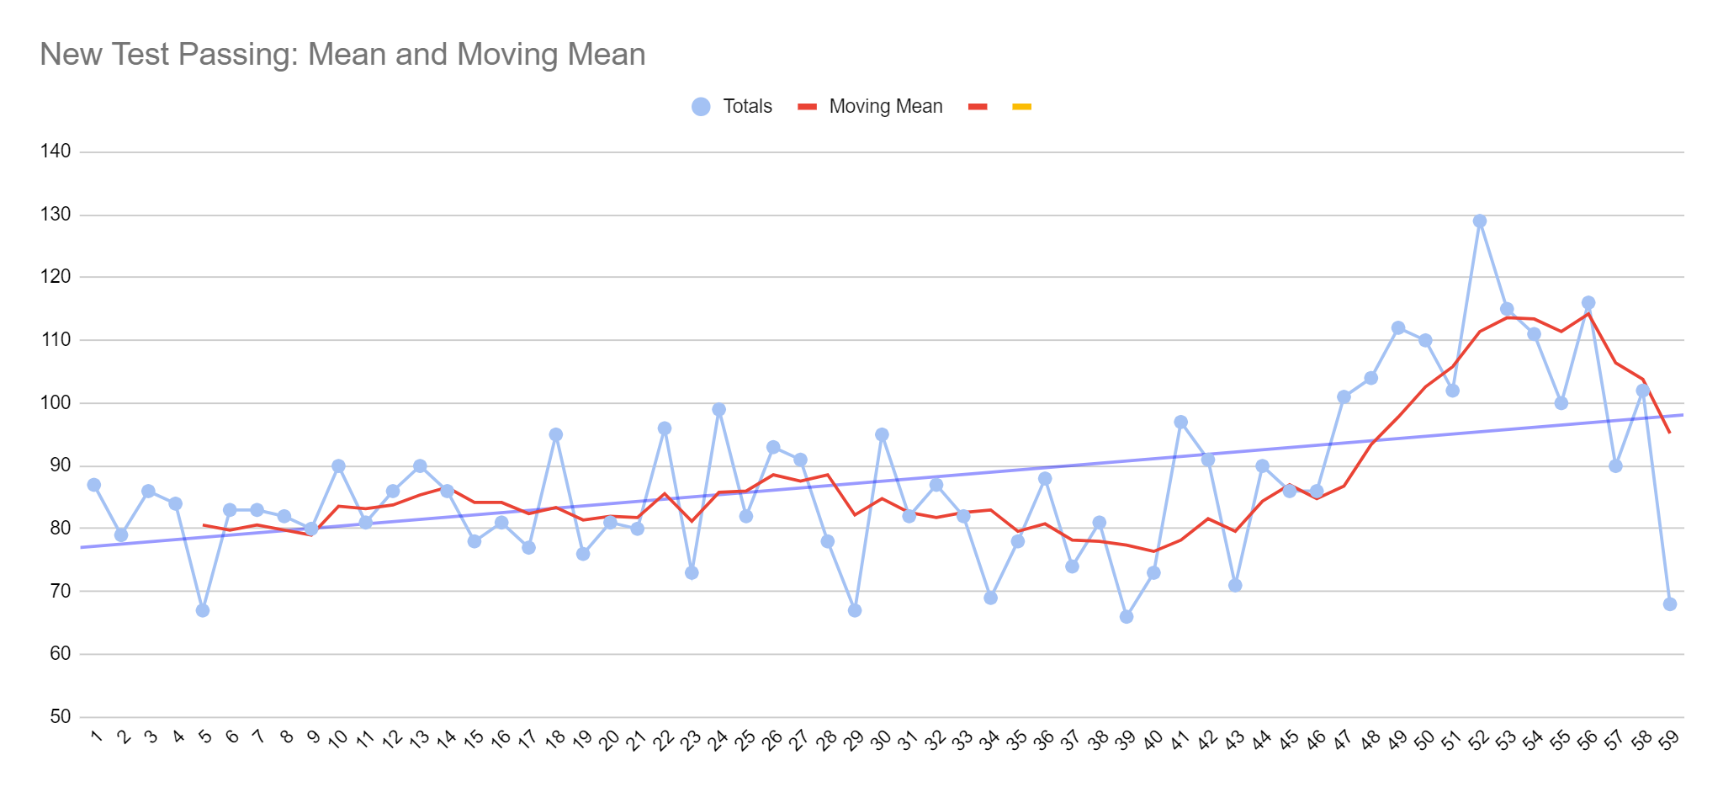
Software Development Process
Evaluate the impact changing the development environment had on productivity.
The new development environment is installed on week 35, marked on the charts below with a black line. Notice the trend of the lines before and after it’s implementation.

Slide 28

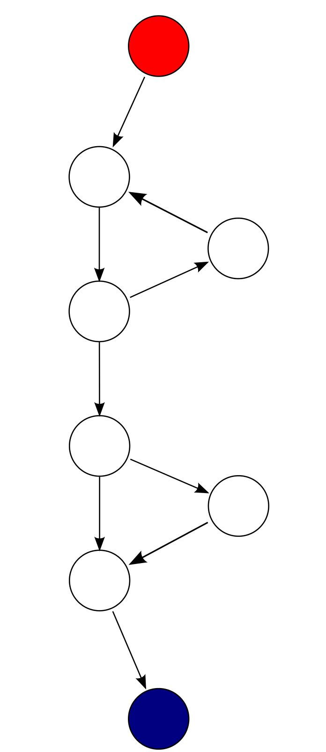
Software Development Process
Is cyclomatic complexity a good predictor for defects?
Cyclomatic Complexity is a representation of a program’s overall complexity.
Uses the Equation M = E − N + 2P where E = the number of edges of the graph. N = the number of nodes of the graph. P = the number of connected components.
Notes:
This graph has 9 edges, 8 nodes, and 1 connected component, so the cyclomatic complexity of the program is 9 - 8 + 2*1 = 3.

Slide 29
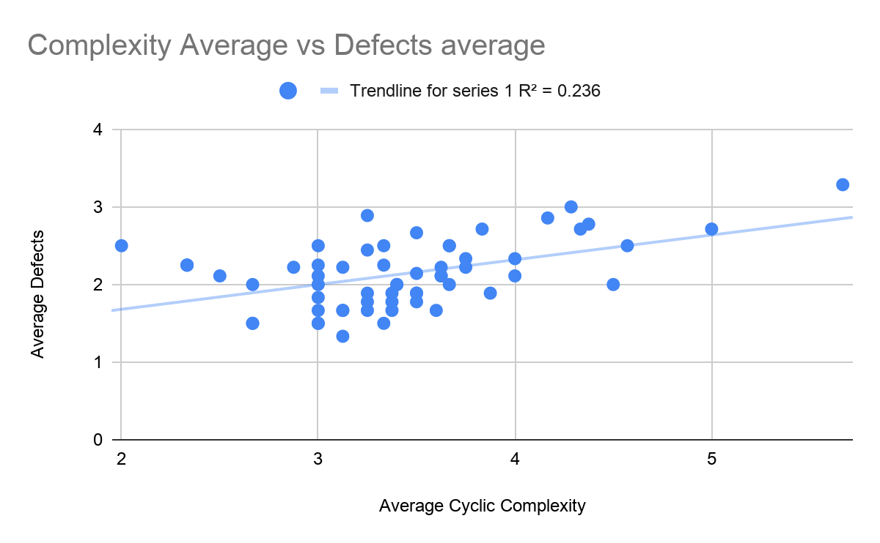
Software Development Process
Is cyclomatic complexity a good predictor for defects?
As Cyclomatic Complexity increase there is some correlation of the number of defects also increasing.
R² = 0.236, suggests slight correlation.

